Slide 1
HIMI RSRT Data Exploration

Slide 2
RDA all species and factors

Slide 3
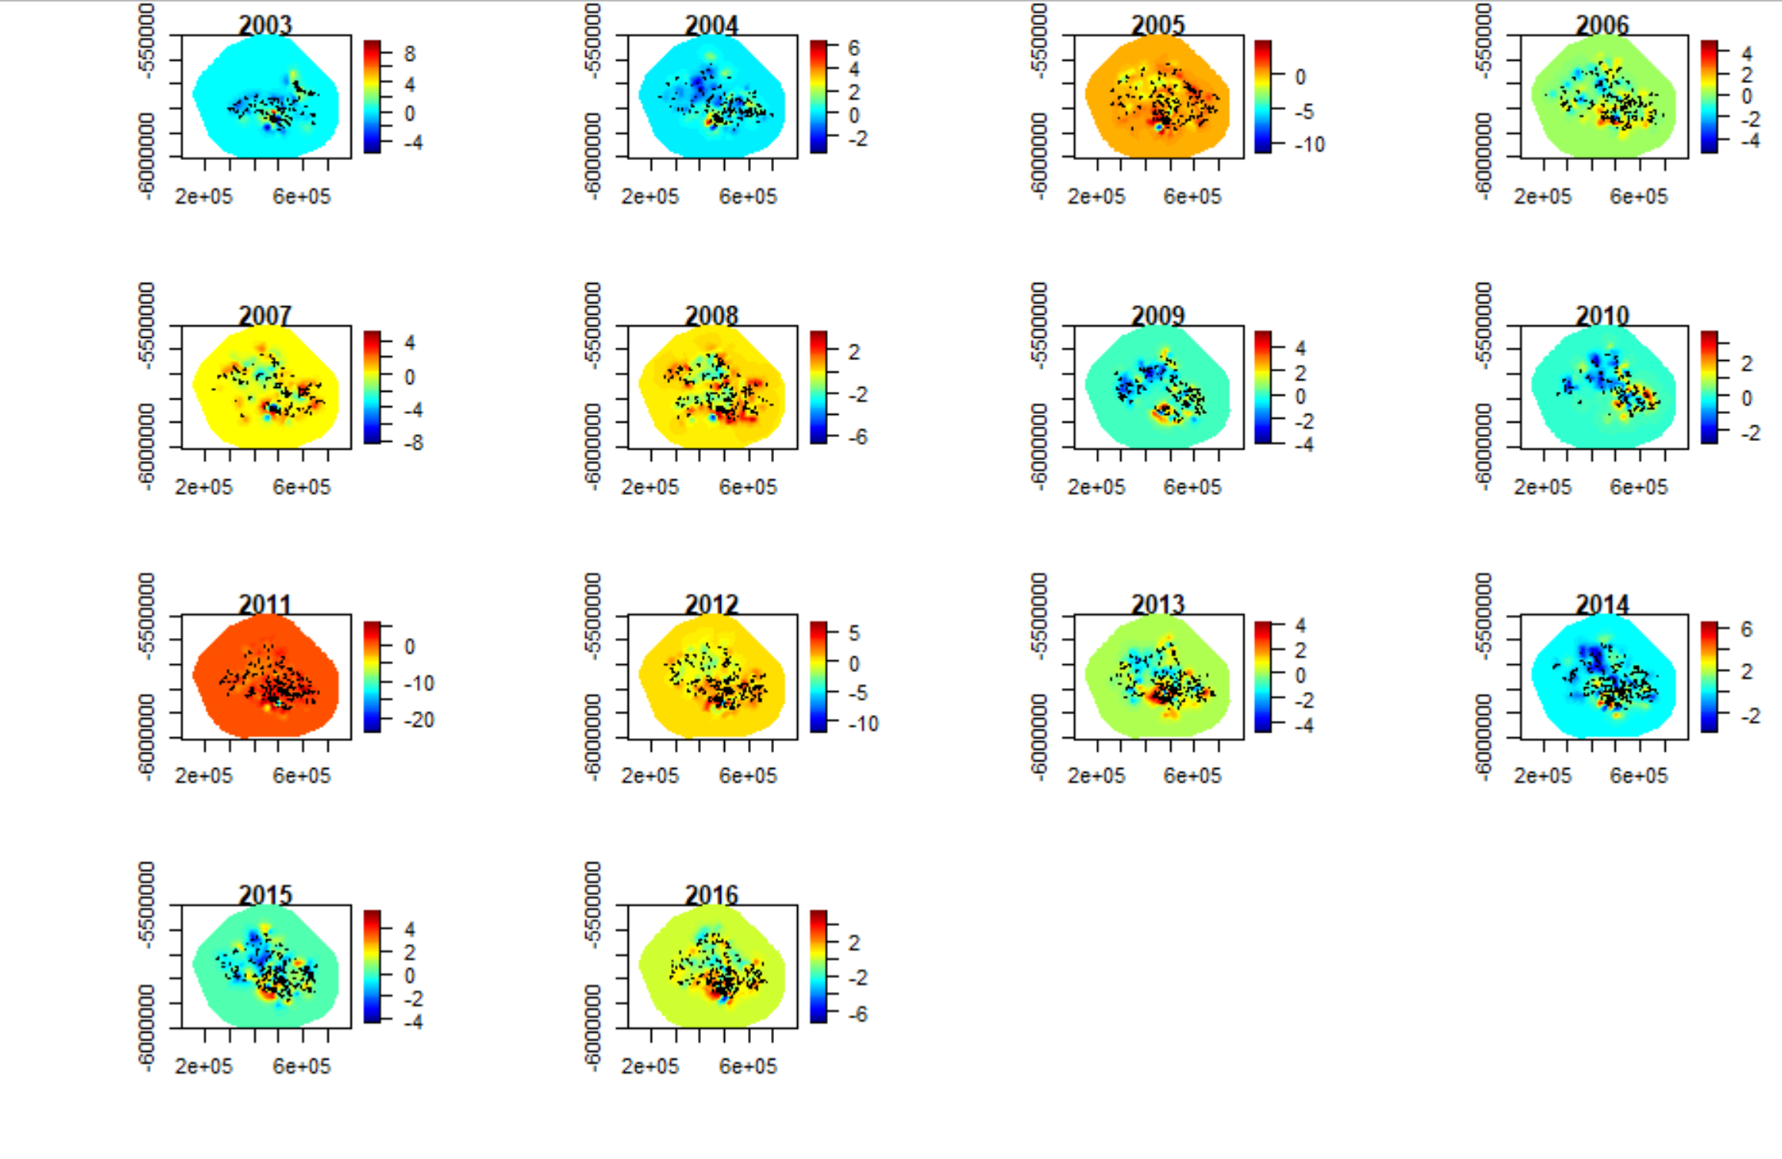
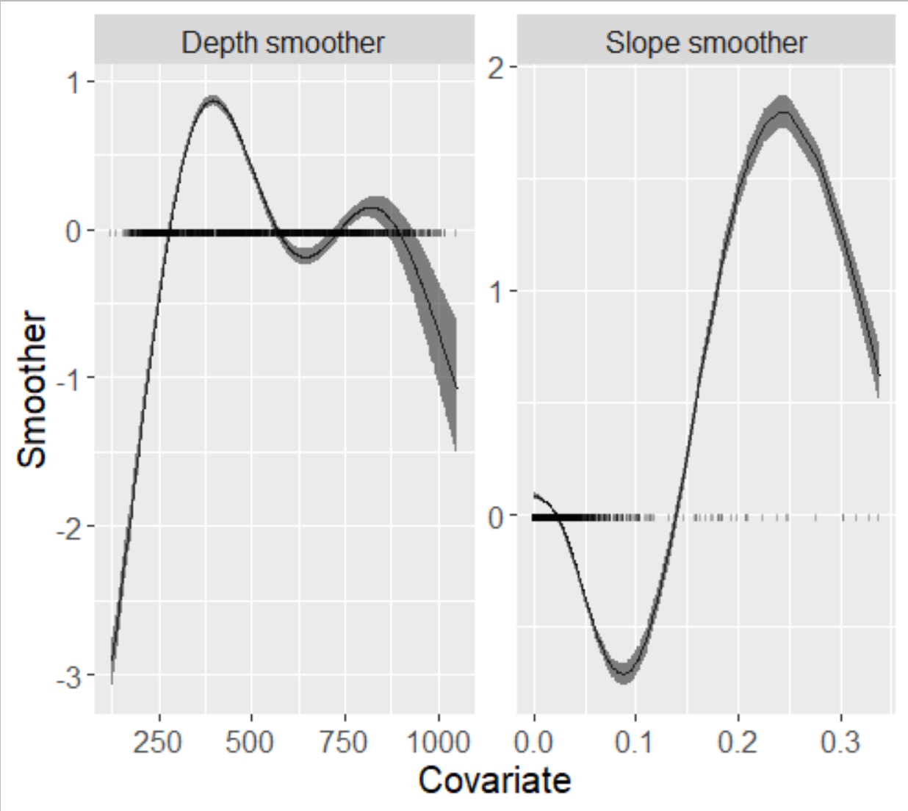
Toothfish
Count ~ fishing depth*year + slope*year + ssh + sst + sst anom. + bottom temp + w*year
Fixed effects:
mean sd 0.025quant 0.5quant 0.975quant mode kld
Intercept 1.929 0.347 1.247 1.930 2.609 1.931 0
fYear2004 -0.471 0.444 -1.343 -0.471 0.402 -0.471 0
fYear2005 -1.217 0.448 -2.098 -1.216 -0.338 -1.215 0
fYear2006 -1.440 0.472 -2.369 -1.439 -0.517 -1.437 0
fYear2007 -1.430 0.460 -2.336 -1.429 -0.530 -1.427 0
fYear2008 -1.725 0.442 -2.595 -1.724 -0.860 -1.723 0
fYear2009 -0.181 0.450 -1.065 -0.181 0.704 -0.182 0
fYear2010 -0.074 0.458 -0.975 -0.075 0.826 -0.075 0
fYear2011 -0.211 0.440 -1.073 -0.211 0.654 -0.212 0
fYear2012 0.007 0.444 -0.862 0.006 0.881 0.004 0
fYear2013 0.038 0.439 -0.822 0.037 0.901 0.035 0
fYear2014 -0.850 0.436 -1.707 -0.850 0.005 -0.850 0
fYear2015 -1.121 0.452 -2.011 -1.121 -0.236 -1.120 0
fYear2016 -1.362 0.448 -2.242 -1.362 -0.483 -1.363 0
ssh.mnt.yr.mn 0.483 0.064 0.358 0.483 0.609 0.483 0
sst.mnt.yr.mn -0.614 0.042 -0.696 -0.614 -0.533 -0.614 0
sst.anom.mnt.yr.mn 0.009 0.073 -0.134 0.009 0.150 0.009 0
bottom_temp -0.015 0.064 -0.140 -0.015 0.113 -0.016 0
*Leaflet map

Slide 4
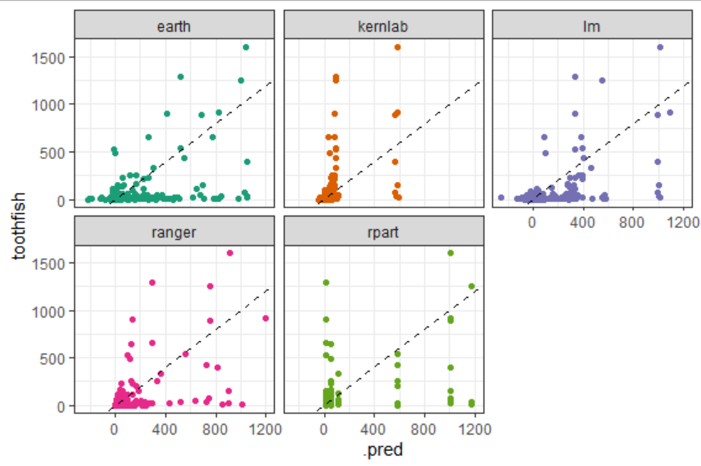
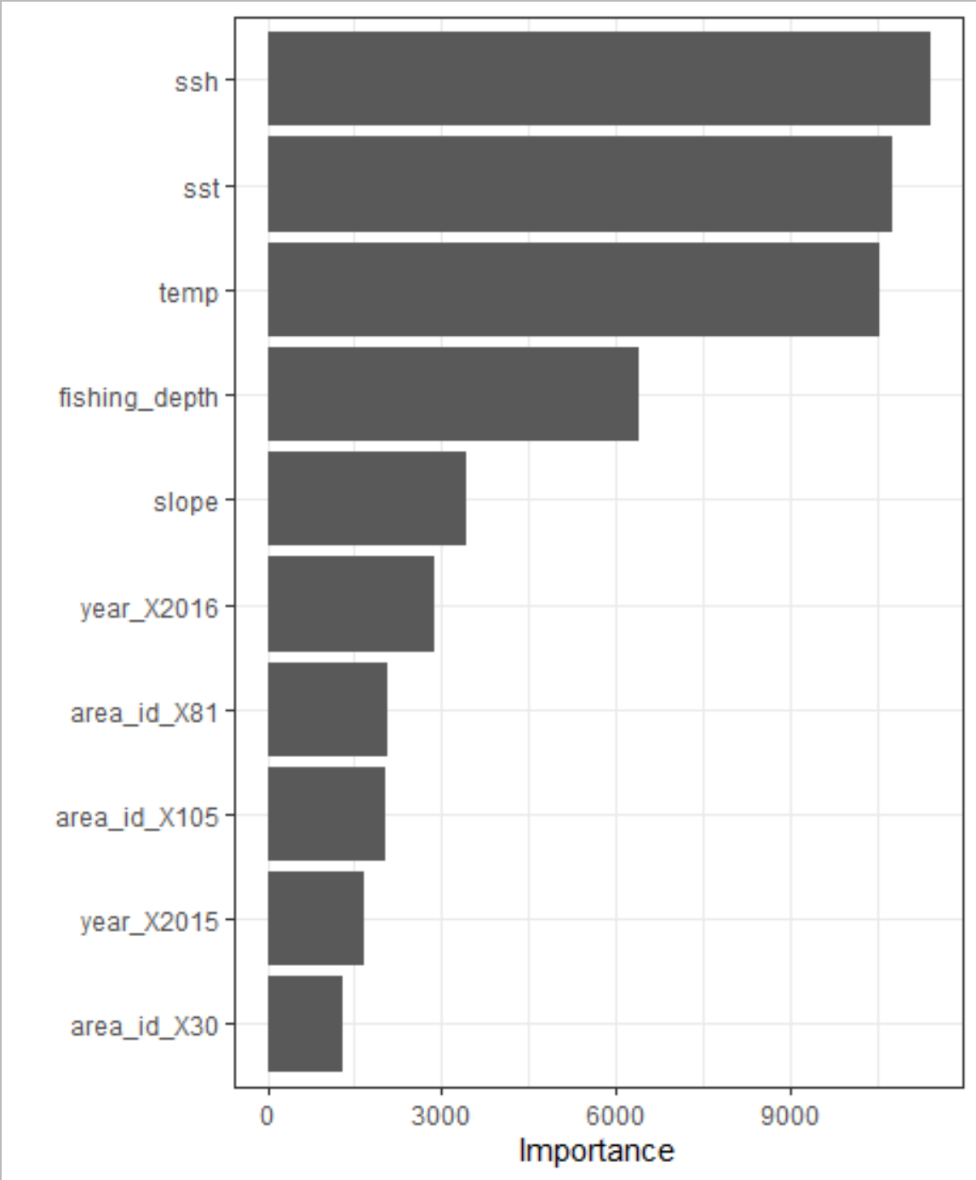
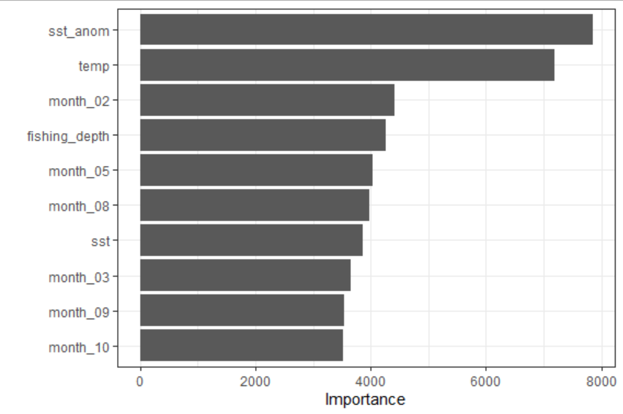
IMAS Tidy models demonstration
Everything Random forest
R2 = 0.32
Simple Random forest
R2 = 0.26

