Slide 1
Mapping, predicting and monitoring ecological change in the Southern Ocean
HIMI RSTS modelling
February 2022

Slide 2
Introduction
Aim: Investigate where and how the fish assemblage of HIMI region has changed in distribution and abundance through time
Since July 2021
Continuing from Skip’s progress
Data preparation completed
Filling in NAs
Environmental variables
Species naming
Data exploration & single species modelling
Multi-species pilot models
Photo credit AFMA

Slide 3
Modelling approach
HMSC – Hierarchical modelling of species communities
RSTS abundance data / CPUE (no. / towed dist.)
Years 2003 – 2016
Removed rare species that occur in <10 samples
Environmental variables:
Depth, slope, aspect,
SST, SST anom., SSH, Chl A,
FESOM: bottom temp., bottom current speed,
SAM, IOD
MPA, year
Random factors: Haul, strata, day since start of study
Hurdle model: presence/absence & abundance conditional presence
Currently refining the model for making predictions
Include traits?
Biomass?

Slide 4
Modelling approach
Y = 35 benthic species* (rare species <10 sample removed)
XFormula ~ poly(fishing_depth, degree = 2, raw = TRUE) + slope + poly(sam, degree = 2, raw = TRUE) + poly(iod, degree = 2, raw = TRUE) + poly(sst_month, degree = 2,raw = TRUE) + poly(sst_anom_month, degree = 2, raw = TRUE) + ssh_month + chla_year + poly(bottom_temp, degree = 2, raw = TRUE) + bottom_speed + zoning + year
Random factors = Spatial (nearest neighbour = 15, max latent variable = 3), strata, days since 1 Jan 2003

Slide 5
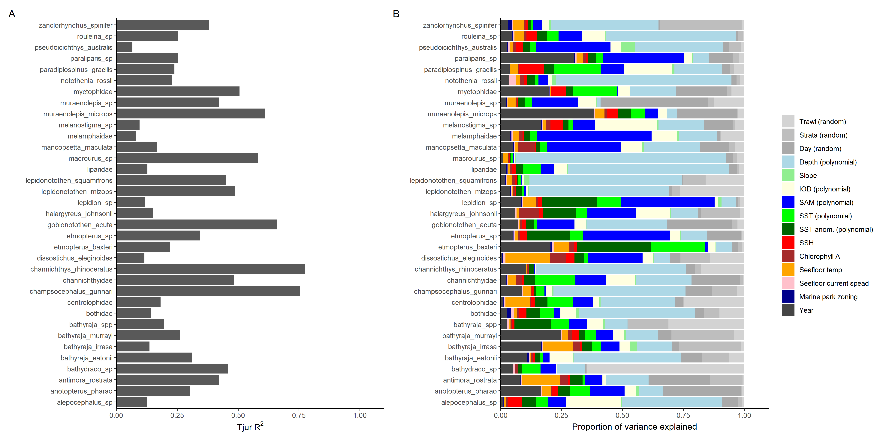
Presence / Absence

Slide 6
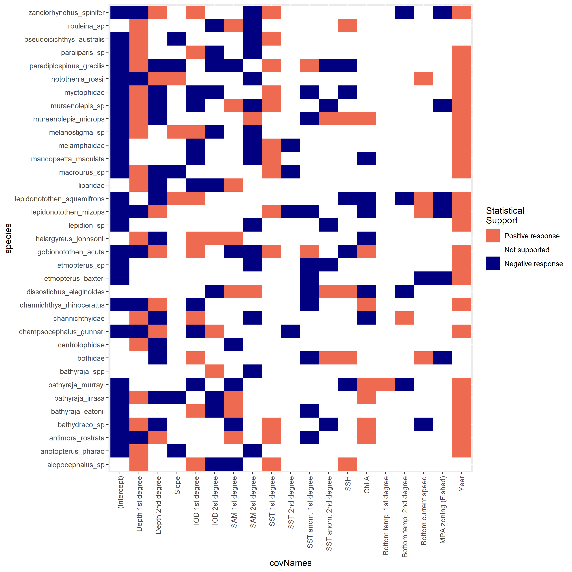
Presence / Absence

Slide 7
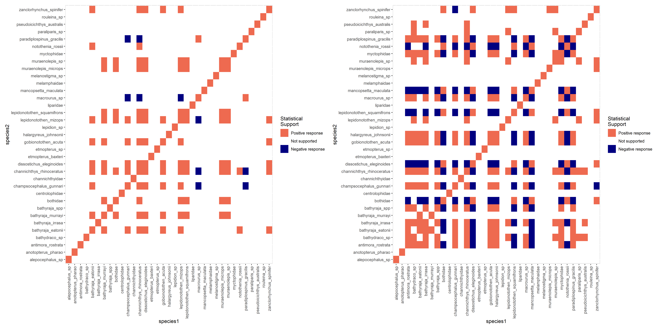
Presence / Absence omega plots

Slide 8
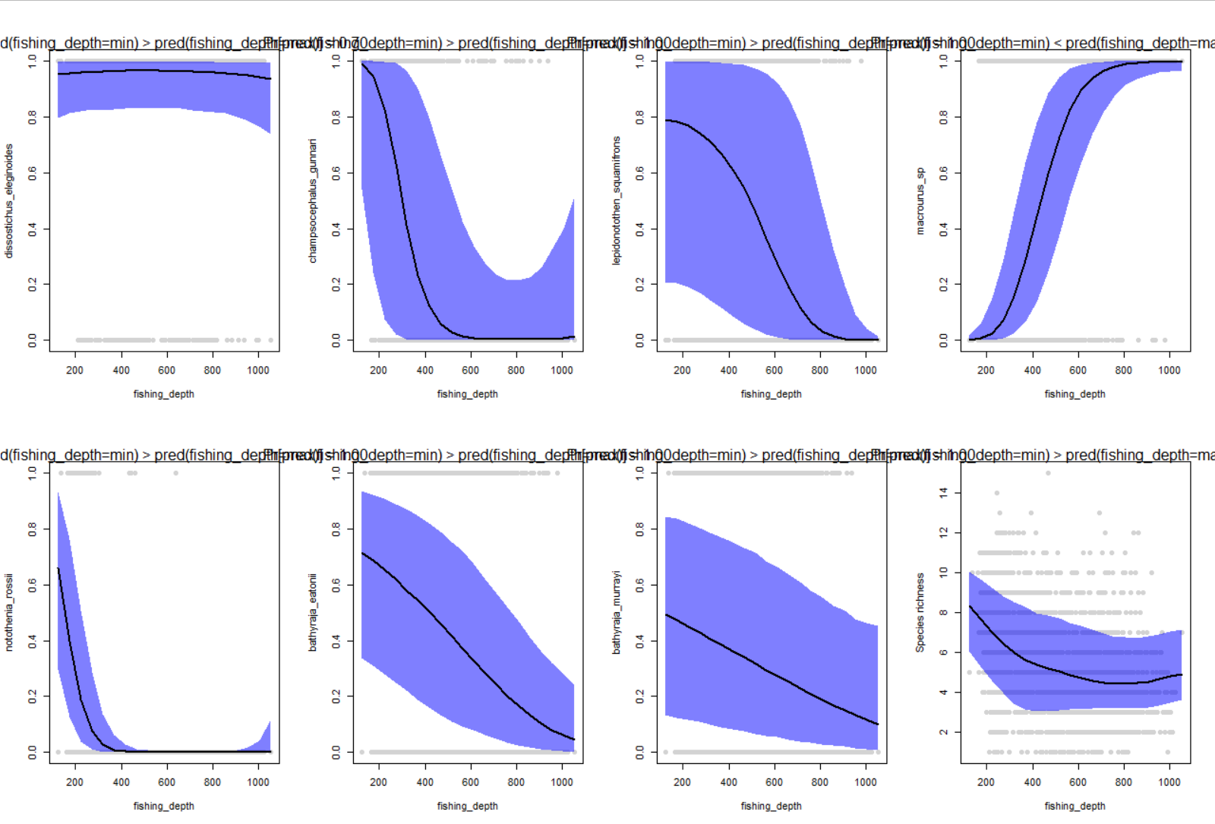

Slide 9
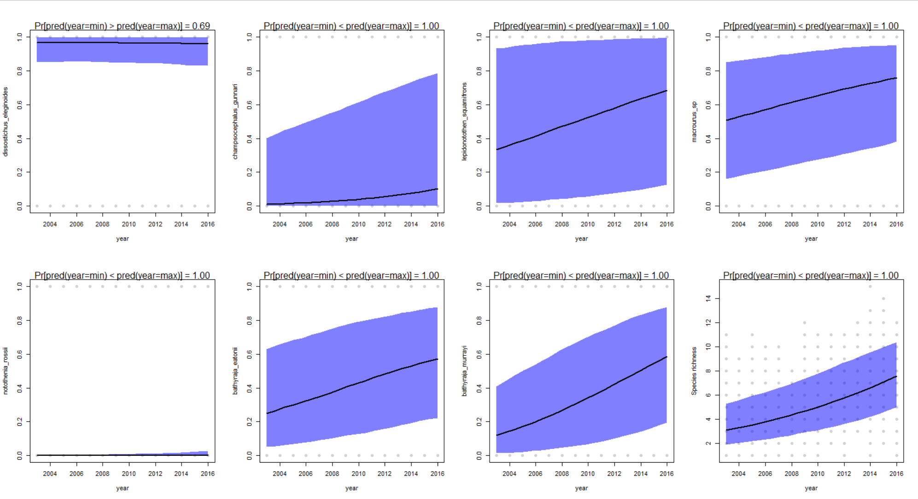

Slide 10
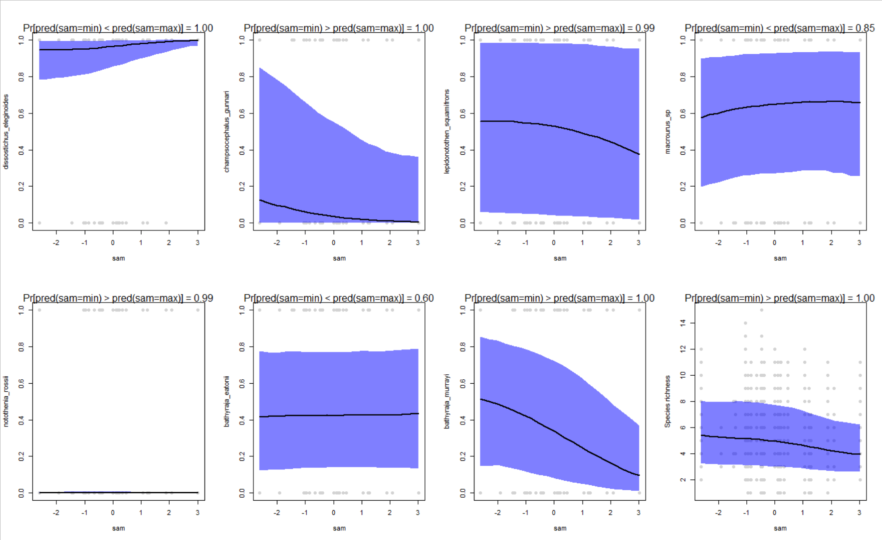

Slide 11
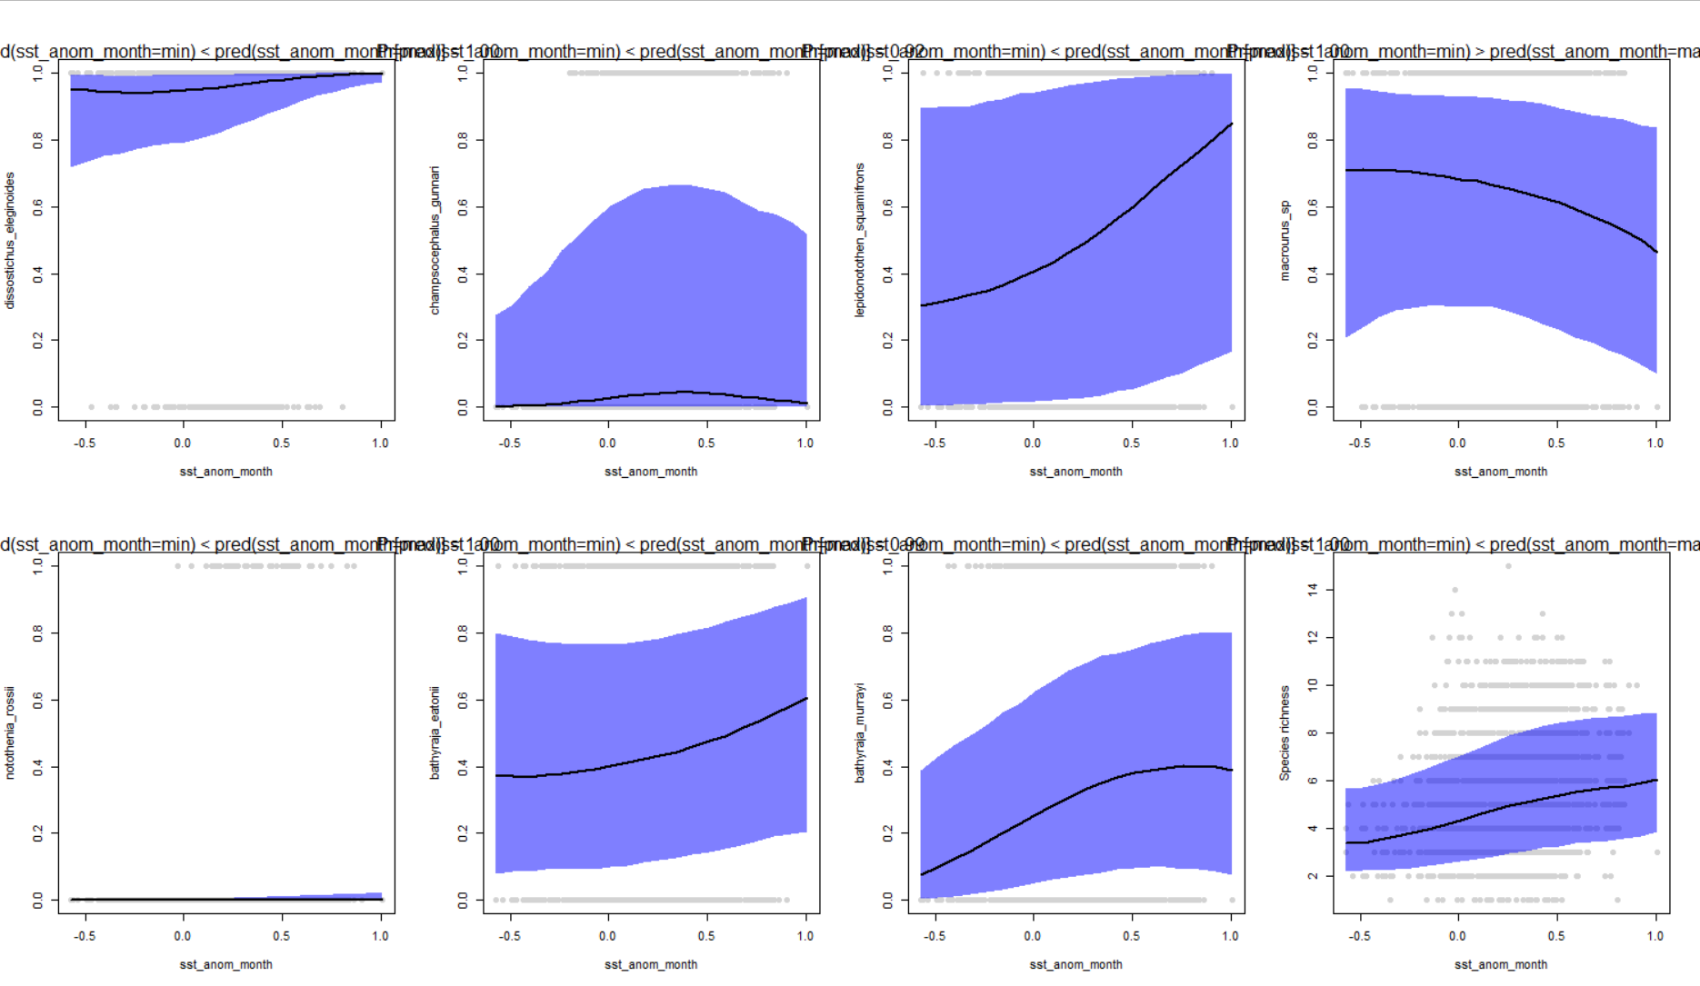

Slide 12
Abundance conditional of presence model

Slide 13
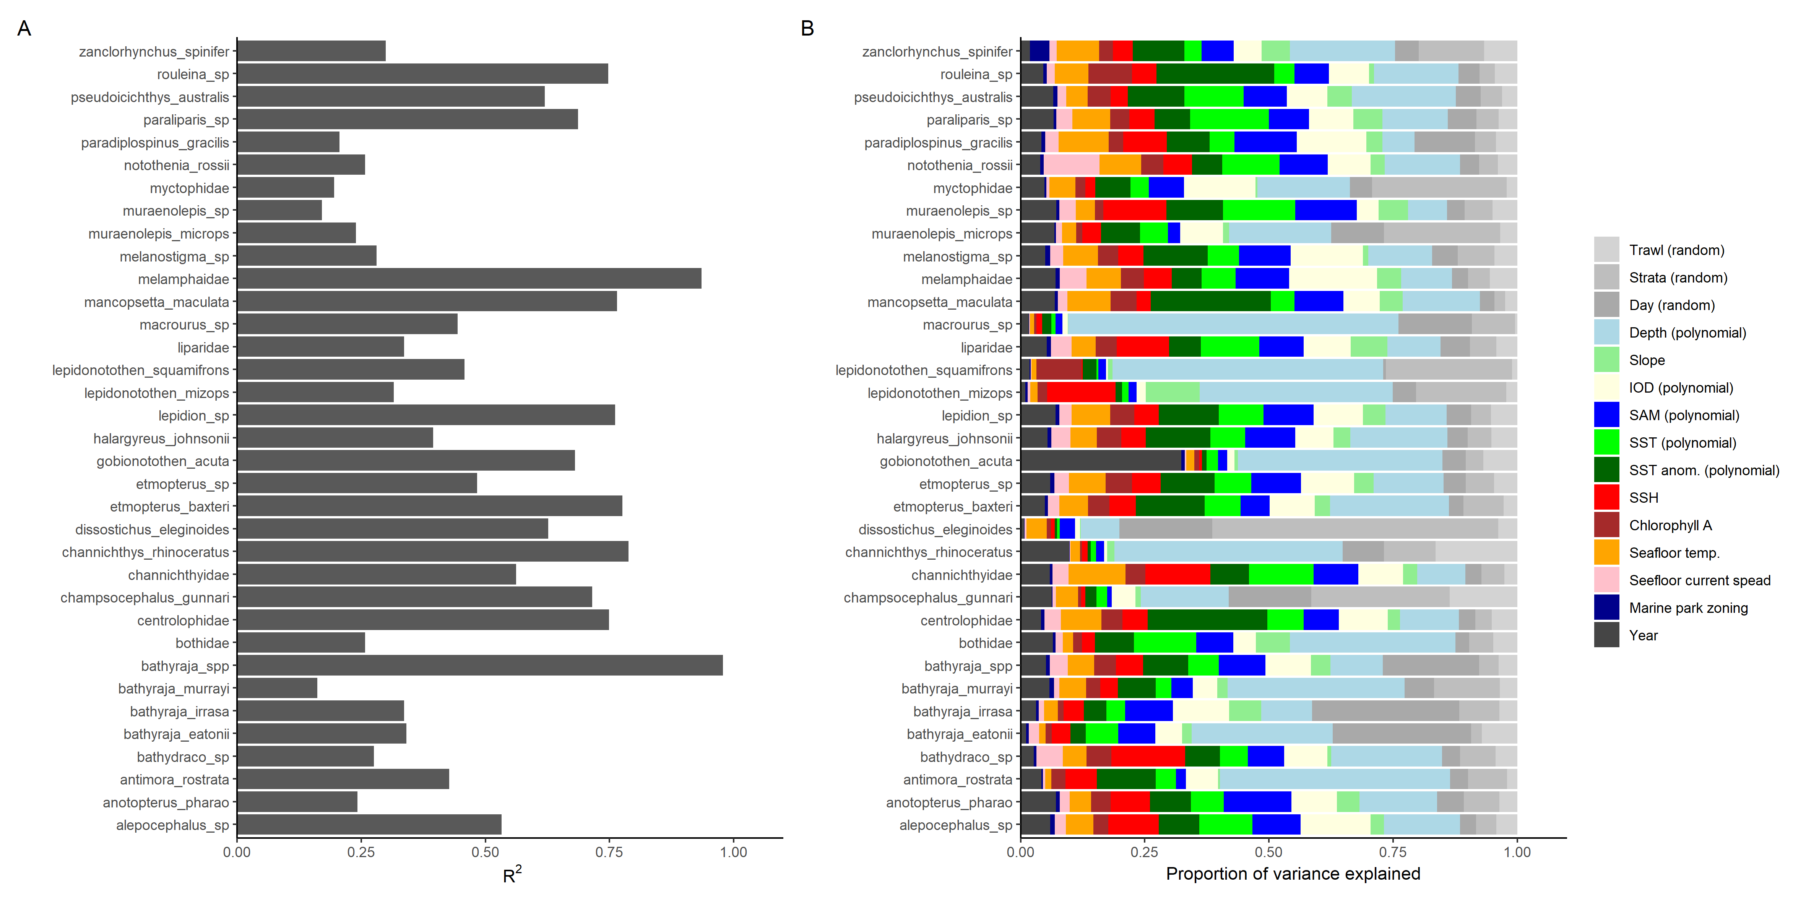
Abundance conditional of presence

Slide 14
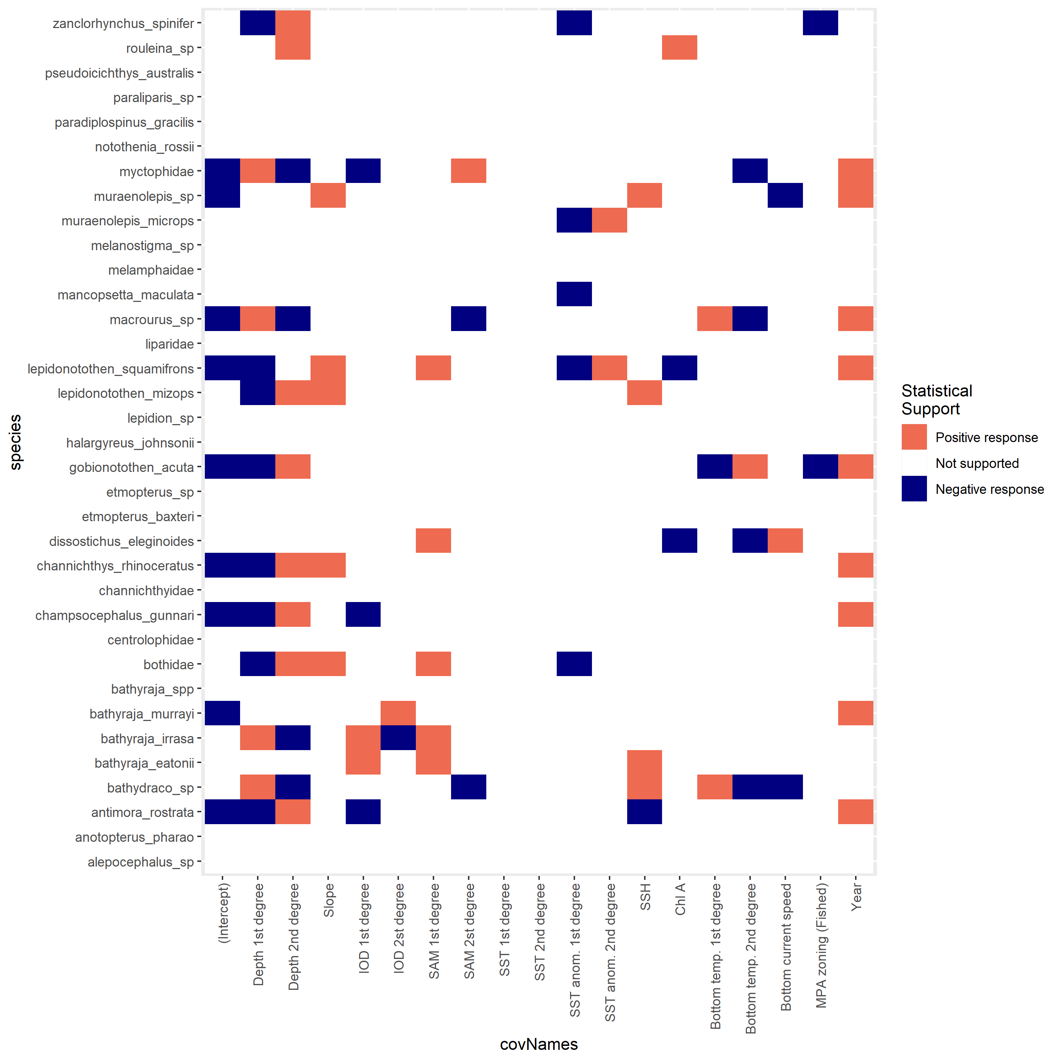
Abundance COP

Slide 15
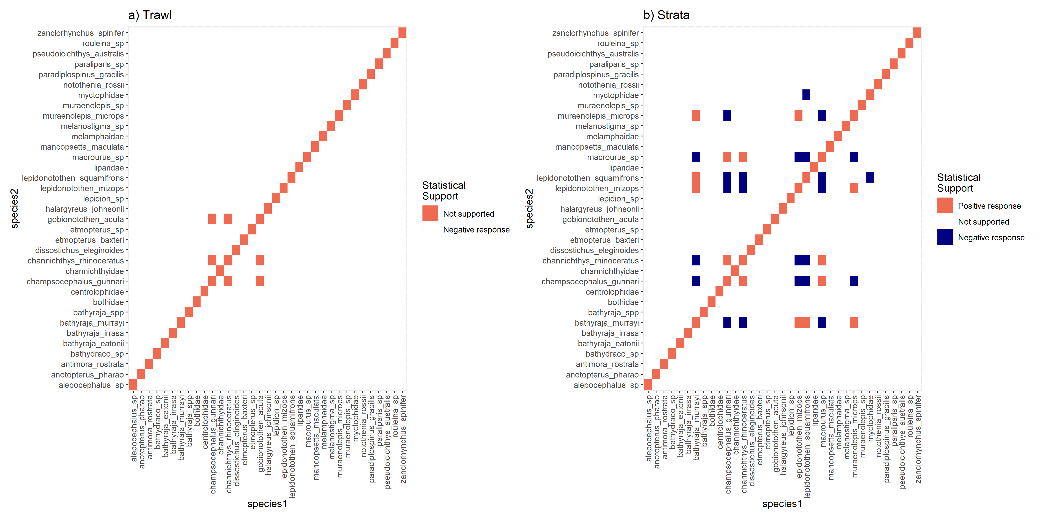
Species – species associations

Slide 16
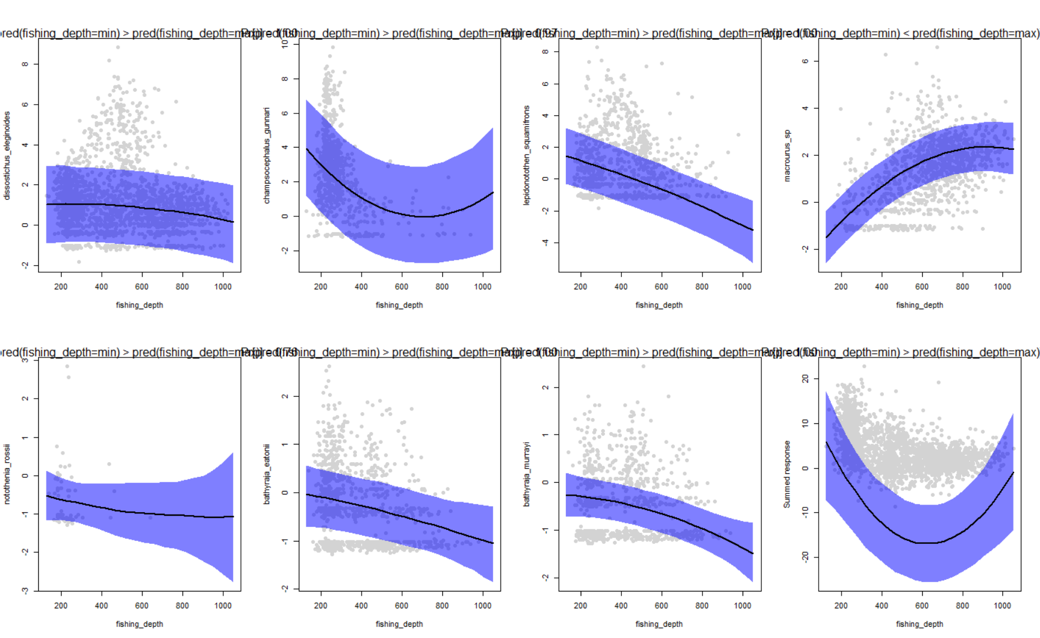

Slide 17
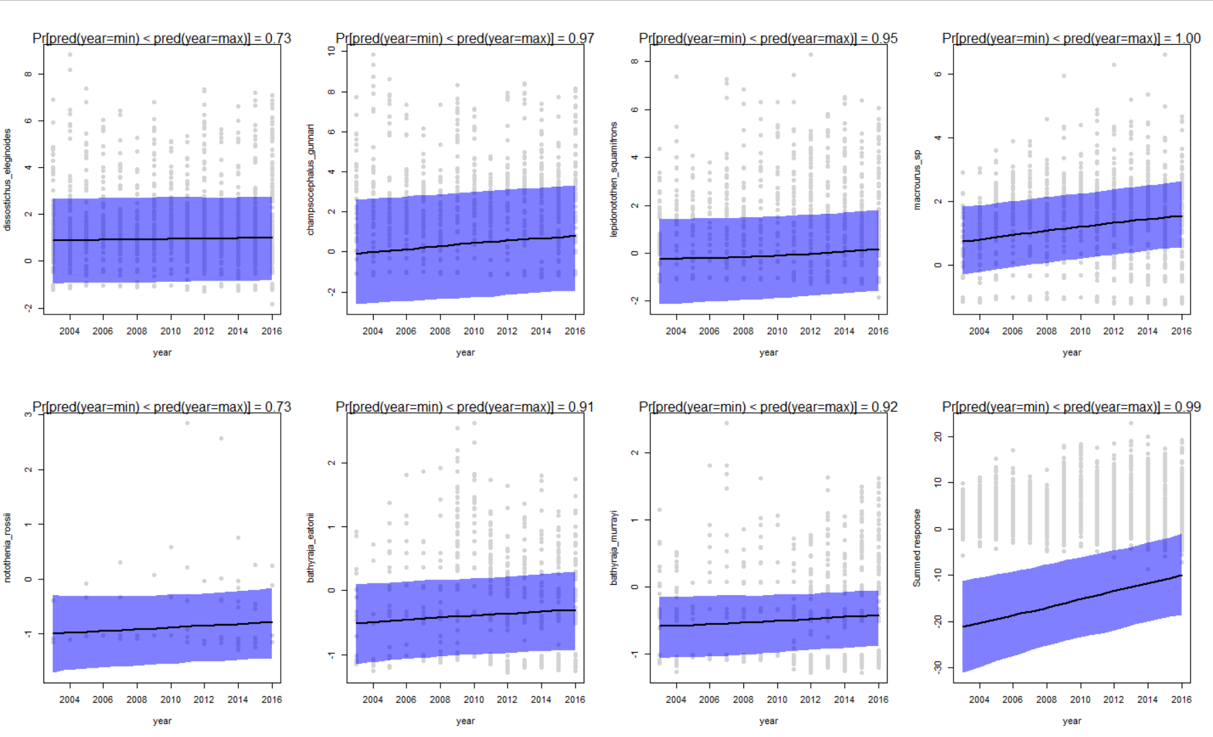

Slide 18
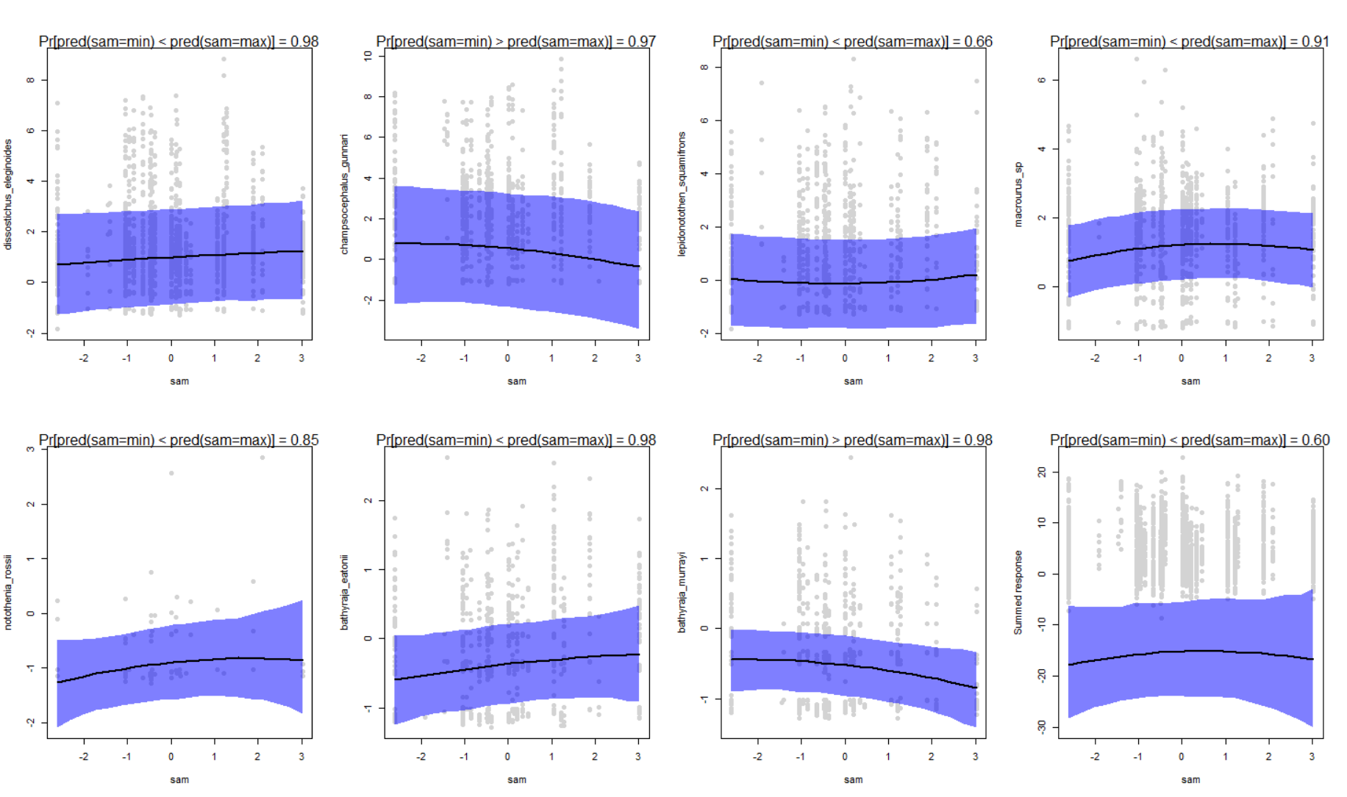

Slide 19
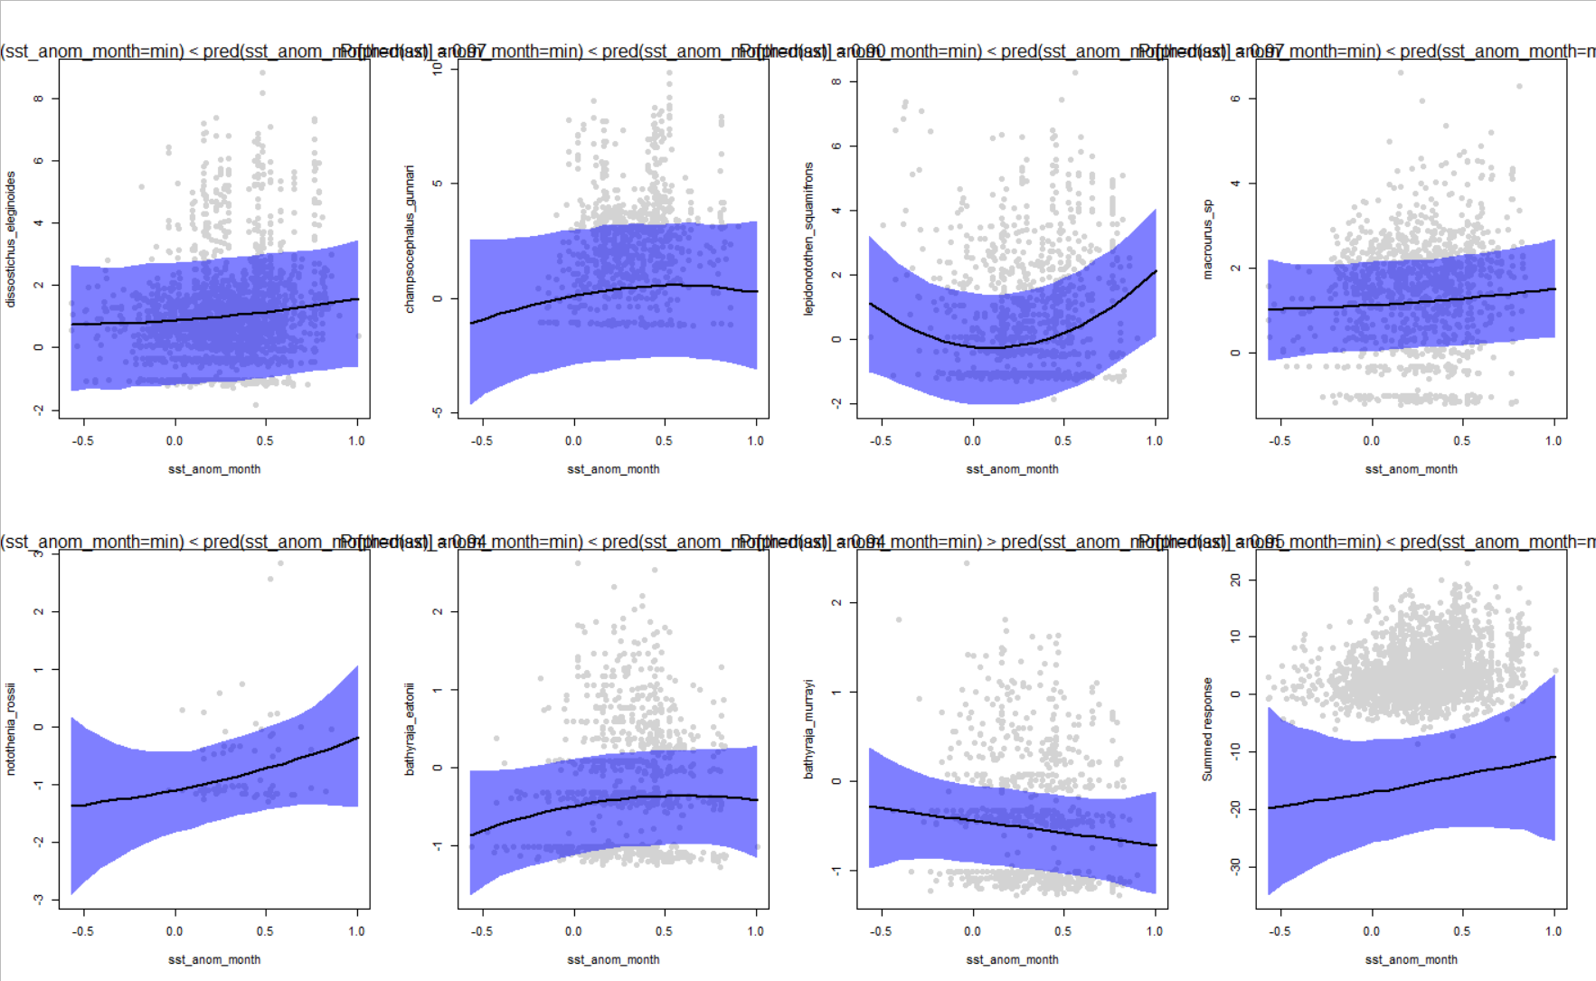

Slide 20
Key message -> Papers
Paper 1?
Presence/Absence
Pres./Abs v Abundance
Year
Abundance COP
Relationships
To what?
Maps
Climate change
Presence / absence
Abundance COP
Combined?
Fishing pressure / management
Paper 2?
Dependence scale Community ecology
Relative strength of information
Traits

